Slide 1

Impact of AI on Today's Business: Revolutionizing Industries with Intelligence
Artificial Intelligence (AI) has transformed the business landscape, empowering organizations to drive innovation, enhance customer experiences, and optimize operations. This presentation will explore the revolutionary impact of AI across various industries, showcasing how intelligence is reshaping the way we work and thrive.
Gaurav Patel

Slide 2
The Rise of Intelligent Automation
Robotic Process Automation
Conversational AI
Predictive Maintenance
Autonomous Systems
Intelligent chatbots and virtual assistants enhance customer support and service delivery.
Self-driving vehicles and drones leverage AI to navigate complex environments safely.
AI-powered bots automate repetitive, high-volume tasks, improving efficiency and accuracy.
AI algorithms analyze sensor data to predict equipment failures and schedule proactive maintenance.

Slide 3

AI-Powered Personalization and Customer Experiences
1
Hyper-Personalized Recommendations
2
Predictive Analytics
AI models forecast customer behavior and preferences to anticipate their needs.
AI algorithms analyze customer data to provide tailored product/service suggestions.
3
Intelligent Chatbots
4
Adaptive User Interfaces
Conversational AI assistants provide instant, personalized support to customers.
AI-driven user interfaces dynamically adjust to individual user preferences and behaviors.

Slide 4
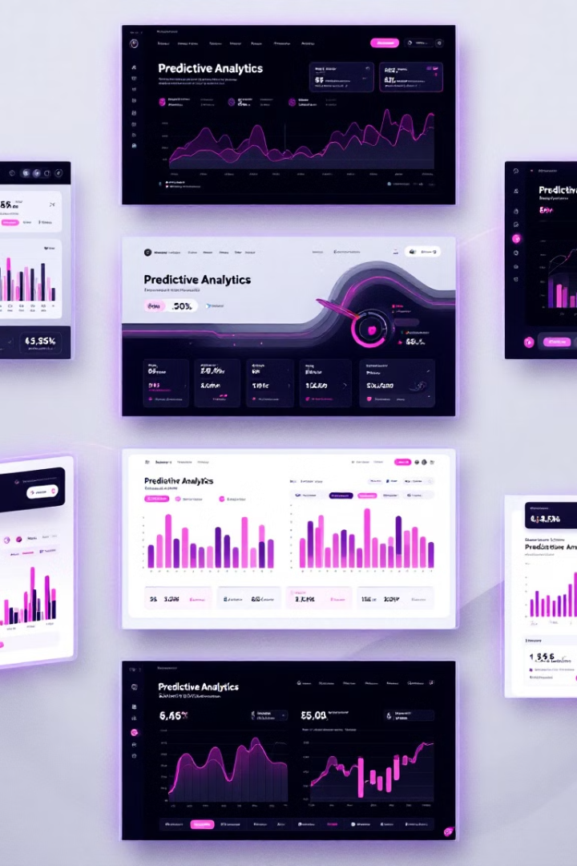
Leveraging Machine Learning for Predictive Analytics
Demand Forecasting
Risk Mitigation
AI models analyze historical data to predict future demand, enabling proactive inventory planning.
Machine learning algorithms identify potential risks and recommend preventive measures.
Process Optimization
Sales Forecasting
AI-powered analytics optimize workflows, streamline operations, and boost productivity.
AI models leverage customer data to predict sales trends and inform strategic decision-making.

Slide 5

AI's Transformative Impact on Supply Chain and Logistics
1
Demand Forecasting
AI-powered demand forecasting optimizes inventory levels and minimizes waste.
2
Route Optimization
AI algorithms analyze real-time data to plan the most efficient delivery routes.
3
Autonomous Vehicles
Self-driving trucks and drones streamline last-mile delivery and reduce human error.

Slide 6





Ethical Considerations and Responsible AI Deployment
Privacy and Security
Algorithmic Bias
Human-AI Collaboration
Regulatory Compliance
Ensuring the secure and ethical use of customer data is critical for building trust.
Proactively addressing AI bias to promote fairness and non-discrimination.
Fostering positive human-AI interaction and preserving meaningful work for employees.
Ensuring AI deployment aligns with evolving legal and ethical frameworks.

Slide 7




Upskilling the Workforce for an AI-Driven Future
Leadership
1
Equipping executives to guide the strategic integration of AI.
Technical Expertise
2
Developing specialized AI and machine learning skills.
Digital Literacy
3
Empowering employees to leverage AI tools and technologies.
Adaptability
4
Fostering a culture of continuous learning and innovation.

Slide 8

Embracing AI Innovation: Strategies for Competitive Advantage
3
85%
Key Focus Areas
Increased Productivity
AI-driven automation and optimization boost operational efficiency.
40%
2X
Revenue Boost
Reduced Costs
AI-powered personalization and predictive analytics drive sales growth.
AI streamlines processes and minimizes errors, leading to significant cost savings.

